Slide 1

API & Kafka: The Digital Highway of Modern Apps
Buckle up for an exciting journey through the world of APIs and Kafka! We're about to discover how modern applications talk to each other in the most fascinating ways.

Slide 2

Once Upon a Time: How Apps Talk to Each Other (API Story)
The Old Days 😅
The Modern Way ✨
Imagine shouting across a crowded market to order chai. You'd need to scream every detail, and half the time, your order would get lost in the noise!
Now imagine having a smart assistant who understands exactly what you want, places your order perfectly, and brings it right to you.
That's what APIs do for applications—making communication smooth, fast, and reliable!
That's how apps used to communicate—messy, unreliable, and exhausting.

Slide 3






Meet API: Your Digital Waiter Taking Orders Between Apps
You Order Food 🍕
You open Swiggy and browse the menu—just like looking at options in a restaurant.
API Takes Your Order 📋
The API carries your request to the restaurant's system—exactly what you want, when you want it.
Kitchen Prepares It 👨‍🍳
The backend system processes your order and gets everything ready for you.
API Delivers Response 🎉
The API brings back the confirmation and tracking info—your food is on the way!

Slide 4
Real-Life API Magic: From Swiggy to WhatsApp
APIs are everywhere! Every time you use your favourite apps, APIs are working behind the scenes like invisible superheroes.
Swiggy Finds Restaurants 🍔
Paytm Processes Payments 💳
Weather Apps Predict Rain 🌧️
APIs connect Swiggy to Google Maps to show you nearby restaurants and delivery times in real-time.
Weather apps use APIs to fetch live data from meteorological departments worldwide every few minutes.
When you pay, APIs securely talk to your bank, verify funds, and confirm your transaction instantly.

Slide 5

Enter Kafka: The Ultimate Message Delivery System
The Challenge 🤔
The Hero: Kafka 🦸‍♂️
Kafka is like a super-efficient post office that can handle millions of messages per second, ensuring nothing gets lost.
What happens when millions of messages need to flow between hundreds of apps simultaneously?
It's the backbone that keeps data flowing smoothly even during peak traffic—like IPL final or Diwali sales!
APIs alone would be like having one postman deliver letters to an entire city!

Slide 6
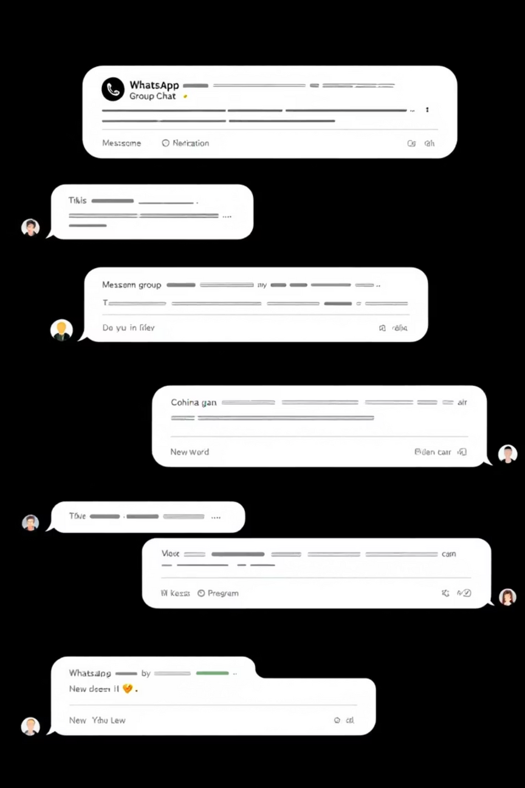



Kafka Explained: Like WhatsApp Groups for Applications
Producer Sends 📤
Like you sending a message to your family group—apps send data to Kafka topics.
Topic Stores 📚
The group chat (topic) keeps all messages organized—everyone can read them anytime.
Consumer Reads 📥
Family members read messages when convenient—apps consume data as they need it.
The magic? Multiple apps can read the same message without interfering with each other. Plus, messages are stored safely even if someone is offline!

Slide 7

The Perfect Match: When APIs Meet Kafka in Action
01
Order Placed via API 🛒
You place an order on Flipkart using their app (API call to their servers).
02
Kafka Distributes Info 📢
Kafka instantly notifies inventory, payment, shipping, and notification systems simultaneously.
03
Each System Responds ⚡
Every system does its job independently—checking stock, processing payment, preparing delivery.
04
APIs Send Updates 🔔
APIs push real-time notifications to your phone—"Order confirmed! Arriving tomorrow!"
Real-world scale: During Big Billion Days, Flipkart processes lakhs of orders per minute using this exact combination!

Slide 8

Bollywood Style: The Drama of Data Flow (Interactive Demo)
1
Act 1: The Hero (User) 🎬
You (the hero) want to book movie tickets on BookMyShow for the latest blockbuster.
2
Act 2: The Messenger (API) 💌
API rushes to the ticket system like a loyal friend, shouting "My friend needs 2 tickets for 7 PM show!"
3
Act 3: The Coordinator (Kafka) 🎪
Kafka coordinates the entire operation—alerting payment gateway, seat allocation, and SMS service simultaneously!
4
Climax: Success! 🎉
Everything synchronizes perfectly—tickets booked, payment done, confirmation SMS sent. Interval time for samosas!

Slide 9

Common Pitfalls: When Things Go Wrong (Memes & Solutions)
The "404 Not Found" Drama 😭
The "Message Lost" Mystery 🕵️
Problem: API endpoint changed but nobody informed your app!
Problem: Kafka consumer crashed and missed important orders!
Solution: Always use versioned APIs (like /v1/orders) and maintain proper documentation.
Solution: Use consumer groups and commit offsets properly—Kafka remembers where you left off.
The "Timeout Timeout" Comedy ⏰
Problem: API takes forever to respond, users get frustrated and abandon carts!
Solution: Set reasonable timeouts, implement retries, and use async processing with Kafka for heavy tasks.

Slide 10



Your Journey Ahead: Building the Next Big Thing
Start Small 🌱
Practice Real Scenarios 💪
Build simple APIs for your projects. Even a basic weather app teaches you valuable concepts!
Try creating a mini food delivery system or chat application using APIs and message queues.
Think Big, Build Bigger 🚀
Companies like Zomato, Ola, and PhonePe are built on these fundamentals. Your idea could be next!
"Every great app you use today started with someone understanding how to make systems talk to each other. Now it's your turn!"

